Slide 1
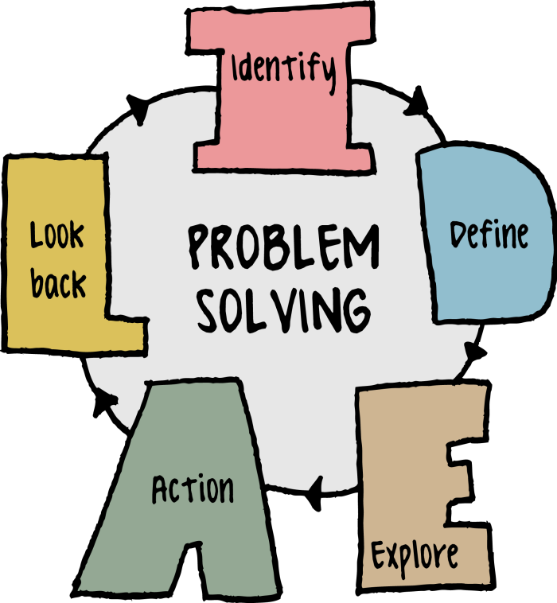
Problem Solving using Python Programming (25CSE0101)
Department of Computer Science and Engineering
Chitkara University, Punjab

Slide 2





Contents
List Comprehension
map, filter & reduce functions
Two Dimensional Lists:
Introduction and Storage
Jagged Lists

Slide 3
List Comprehension
List comprehension offers a shorter syntax when you want to create a new list based on the values of an existing list.
It is used to define a list based on an existing iterable object, such as a list, tuple, or string, and apply an expression to each element in the iterable.
The Syntax
newlist = [expression for item in iterable if condition == True]
The return value is a new list, leaving the old list unchanged. The condition is like a filter that only accepts the items that valuate to True.

Slide 4
List Comprehension
Example: Based on a list of fruits, you want a new list, containing only the fruits with the letter "a" in the name. Without list comprehension you will have to write a for statement with a conditional test inside:
# Using List Comprehension:
# Short list of fruits
fruits = ["apple", "pear", "plum"]
# List comprehension to find fruits with 'a'
fruits_with_a = [fruit for fruit in fruits if 'a' in fruit]
# Print the result
print(fruits_with_a)
Output:
['apple', 'pear']

Slide 5
List Comprehension
# Without List Comprehension (Using a for loop with if condition):
# Short list of fruits
fruits = ["apple", "pear", "plum"]
# Empty list to store the results
fruits_with_a = []
# Loop through the list of fruits
for fruit in fruits:
if 'a' in fruit:
fruits_with_a.append(fruit)
# Print the result
print(fruits_with_a)
Output:
['apple', 'pear']

Slide 6
List Comprehension
suppose we have list of numbers and we desire to create a new list containing the double value of each element in the list.
# List of numbers
numbers = [1, 2, 3, 4, 5]
# Using list comprehension to create a new list with double the value of each number
doubled_numbers = [number * 2 for number in numbers]
# Print the result
print(doubled_numbers)
Output:
[2, 4, 6, 8, 10]

Slide 7
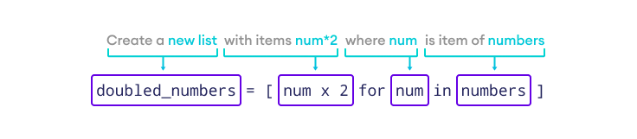
List Comprehension
Here is how the list comprehension works:

Slide 8
List Comprehension
for Loop vs. List Comprehension
List comprehension makes the code cleaner and more concise than for loop. Let's write a program to print the square of each list element using both for loop and list comprehension.
# square of each list element using for loop
# numbers
List of numbers= [1, 2, 3, 4, 5]
# Empty list to store the squared values
squares = []
# Using a for loop to square each number and append it to the new list
for number in numbers:
squares.append(number ** 2)
# Print the squared values
print(squares)

Slide 9
List Comprehension
for Loop vs. List Comprehension
# square of each list element using List comprehension
# List of numbers
numbers = [1, 2, 3, 4, 5]
# List comprehension to square each number
squares = [number ** 2 for number in numbers]
# Print the squared values
print(squares)
Output:
[1, 4, 9, 16, 25]

Slide 10
List Comprehension
Conditionals in List Comprehension
List comprehension can utilize conditional statements like if…else to filter existing lists.
Let's see an example of an if statement with list comprehension.
# List comprehension to get even numbers from a given range
even_numbers = [num for num in range(1, 10) if num % 2 == 0]
# Output the list of even numbers
print(even_numbers)
Output
[2, 4, 6, 8]
Here, list comprehension checks if the number from range(1, 10) is even or odd. If even, it appends the number in the list.
The range() function generates a sequence of numbers.

Slide 11
List Comprehension
List Comprehension on strings in Python
You can create a new list with the individual characters contained in a given string.
fave_language_chars=[letter for letter in "Python"]
print(fave_language_chars)
#output
#['P', 'y', 't', 'h', 'o', 'n']
The new list that gets created is comprised of all the separate letters contained in the string "Python", which acts as an iterable.
Just like numbers, you can perform operations on the characters contained in a string and customize them depending on how you want them to be in the new list you create.

Slide 12
List Comprehension
List Comprehension on strings in Python
If you wanted all letters to be uppercase, you would do the following:
fave_language_chars_upper=[letter.upper() for letter in "Python"]
print(fave_language_chars_upper)
#output
#[‘P', ‘Y', ‘T', ‘H', ‘O', ‘N']
Here you use the .upper() method to convert every single letter in "Python" to uppercase and add them to the fave_language_chars_upper variable. The same goes if you wanted all your letters to be lowercase - you'd instead use the lower() method.

Slide 13
Map, Filter & Reduce functions
Map Function
The map() function allows you to iterate over each item in an iterable. It operates independently on each item rather than producing a single result.
Finally, the map() function can be used to perform mathematical operations on two or more lists. It can even be used to manipulate any type of array.
Syntax:
map(function, iterable) Parameters
function − The function to be used in the code.
iterable − This is the value that is iterated in the code.

Slide 14
Map, Filter & Reduce functions
Example1: In this example, Python program showcases the usage of the map function to double each number in a given list by applying the double function to each element, and then printing the result as a list.
# Function to return double of n
def double(n):
return n * 2
# Using map to double all numbers
numbers = [5, 6, 7, 8]
result = map(double, numbers)
print(list(result))
Output[10, 12, 14, 16]

Slide 15
Map, Filter & Reduce functions
Example2: Use the map() function for applying the multiplyNumbers() function for each element of the list by passing the function name, and list as arguments to it.
# creating a function that returns multiplication result
def multiplyNumbers(givenNumbers):
# returning number after multiplying with 3
return givenNumbers*3
# map() function applies the multiplyNumbers function for each element
givenNumbers = map(multiplyNumbers, [1, 3, 5, 2, 6, 10])
# Printing the resultant list items
print("Multiplying list elements with 3:")
for element in givenNumbers:
print(element, end=",")
Output:
Multiplying list elements with 3:
3,9,15,6,18,30,

Slide 16
Map, Filter & Reduce functions
Example3: Another example of using map() is to convert a list of strings to integers:
strings = ["1", "2", "3", "4", "5"] numbers = list(map(int, strings)) print(numbers)
Output:
[1, 2, 3, 4, 5]
In this example, we use the int() function to convert each string to an integer.

Slide 17
Map, Filter & Reduce functions
Filter Function
The filter() function in Python is used to filter elements from an iterable (like a list) based on a condition provided by a function.
This function is defined in “functools” module.
Syntax:
filter(function, iterable)
function − The function to be used in the code.
iterable − This is the value that is iterated in the code.

Slide 18
Map, Filter & Reduce functions
Example1: Filter numbers greater than a specific value
This program filters out numbers that are greater than 50 from a list.
# List of numbers
numbers = [23, 45, 67, 12, 89, 38, 55]
# Using filter() to filter out numbers greater than 50
numbers_greater_than_50 = list(filter(lambda x: x > 50, numbers))
# Output the result
print("Numbers greater than 50:", numbers_greater_than_50)
Output:
Numbers greater than 50: [67, 89, 55]
The lambda function checks if each number is greater than 50.
The filter() returns a list of numbers that satisfy this condition.

Slide 19
Map, Filter & Reduce functions
Example2: Here's a simple example using filter() to get even numbers from a list:
# Define a function to check if a number is even
def is_even(number):
return number%2 == 0
# List of numbers
numbers = [1, 2, 3, 4, 5, 6, 7, 8, 9, 10]
# Use filter() to get even numbers
even_numbers = list(filter(is_even, numbers))
print("Even numbers:", even_numbers)
Output:
Even numbers: [2, 4, 6, 8, 10]

Slide 20
Map, Filter & Reduce functions
Reduce Function
In Python, the reduce() function iterates through each item in a list or other iterable data type, returning a single value. It's in the functools library. This is more efficient than looping.
from functools import reduce
Syntax:
reduce(function, iterable)
function − The function to be used in the code.
iterable − This is the value that is iterated in the code.

Slide 21
Map, Filter & Reduce functions
Example1: Sum of a list of numbers
from functools import reduce
# Define a function to add two numbers
def add(x, y):
return x + y
# List of numbers
numbers = [1, 2, 3, 4, 5]
# Use reduce() to sum up the numbers
sum_of_numbers = reduce(add, numbers)
print("Sum of numbers:", sum_of_numbers)
Output:
Sum of numbers: 15

Slide 22
Map, Filter & Reduce functions
Example2: Product of a list of numbers
from functools import reduce
# Define a function to multiply two numbers
def multiply (x, y):
return x * y
# List of numbers
numbers = [1, 2, 3, 4, 5]
# Use reduce() to get the product of the numbers
product_of_numbers = reduce(multiply, numbers)
print(“Product of numbers:", product_of_numbers )
Output:
Sum of numbers: 120

Slide 23
Map, Filter & Reduce functions
Example3: Finding the maximum value in a list
from functools import reduce
# Define a function to find the maximum of two numbers
def find_max(x, y):
return x if x > y else y
# List of numbers
numbers = [3, 5, 2, 8, 6, 1]
# Use reduce() to find the maximum number
max_value = reduce(find_max, numbers)
print("Maximum value:", max_value)
Output:
Maximum value: 8

Slide 24
Two Dimensional Lists: Introduction and Storage
A 2D List (Two-Dimensional List) in Python is a list where each element is itself a list. This creates a matrix-like structure with rows and columns, making it useful for representing tables, grids, or any data in two dimensions.
Example of a 2D List:
matrix = [
[1, 2, 3], # Row 0
[4, 5, 6], # Row 1
[7, 8, 9] # Row 2
]
In this example: The list matrix contains 3 rows, each represented by a list of values. You can think of it like a table with 3 rows and 3 columns.

Slide 25
Two Dimensional Lists: Introduction and Storage
Accessing Elements: You can access elements in a 2D list using two indices—one for the row and one for the column:
matrix = [
[1, 2, 3], # Row 0
[4, 5, 6], # Row 1
[7, 8, 9] # Row 2
]
print(matrix[1][2]) # Output: 6

Slide 26
Two Dimensional Lists: Introduction and Storage
How 2D Lists are Stored in Memory?
In Python, 2D lists are stored in memory using a technique called row-major order, meaning the list is stored row by row.
Row-Major Order:
Each row in the 2D list is stored sequentially in memory.
2. The 2D list is essentially a list of lists, so each inner list (row) is treated as a separate object, and Python stores pointers (references) to these lists.

Slide 27
Two Dimensional Lists: Introduction and Storage
How 2D Lists are Stored in Memory?
Example : Consider the following 2D list (matrix):
matrix = [
[1, 2, 3],
[4, 5, 6],
[7, 8, 9]
]
In memory, this would be stored like this:
[1, 2, 3, 4, 5, 6, 7, 8, 9]
But logically, it still maintains the row structure:
First row: [1, 2, 3]
Second row: [4, 5, 6]
Third row: [7, 8, 9]

Slide 28
Two Dimensional Lists: Introduction and Storage
Program 1: Create and Print a 2D List
This program creates a 2D list and prints it.
# Creating a 2D list
matrix = [
[1, 2, 3],
[4, 5, 6],
[7, 8, 9]
]
# Printing the 2D list (matrix)
for row in matrix:
print(row)
Output:
[1, 2, 3]
[4, 5, 6]
[7, 8, 9]

Slide 29
Two Dimensional Lists: Introduction and Storage
Program 2: Input a 2D List from the User
This program takes input for a 2x2 matrix from the user and prints it.
matrix = []
# Input 2x2 matrix from the user
for i in range(2):
row = []
for j in range(2):
value = int(input(f"Enter value for element [{i}][{j}]: "))
row.append(value)
matrix.append(row)
# Print the 2D list
print("The 2D list (matrix) is:")
for row in matrix:
print(row)

Slide 30
Two Dimensional Lists: Introduction and Storage
Program 3: Sum of All Elements in a 2D List
This program calculates the sum of all elements in a 2D list.
matrix = [
[1, 2, 3],
[4, 5, 6],
[7, 8, 9]
]
total_sum = 0
# Calculate the sum of all elements
for row in matrix:
total_sum += sum(row)
print("Total sum of all elements:", total_sum)
Output:
Total sum of all elements: 45

Slide 31
Two Dimensional Lists: Introduction and Storage
Program 4: Transpose of a 2D List
This program computes the transpose of a matrix (swap rows and columns).
matrix = [
[1, 2, 3],
[4, 5, 6],
[7, 8, 9]
]
# Transpose the matrix
transpose = [[matrix[j][i] for j in range(3)] for i in range(3)]
# Print the transposed matrix
for row in transpose:
print(row)
Output:
[1, 4, 7]
[2, 5, 8]
[3, 6, 9]

Slide 32
Jagged Lists
Jagged Lists: A Jagged List (also known as an irregular list or ragged array) is a list of lists where the inner lists can have different lengths. Unlike a regular 2D list (matrix), where all rows have the same number of columns, in a jagged list, each row can have a different number of elements.
Example of a Jagged List:
jagged_list = [
[1, 2, 3], # Row 1 has 3 elements
[4, 5], # Row 2 has 2 elements
[6, 7, 8, 9] # Row 3 has 4 elements
]
In this example:
The first row has 3 elements.
The second row has 2 elements.
The third row has 4 elements.

Slide 33
Jagged Lists
Accessing Elements: You can access elements of a jagged list the same way as in a regular 2D list using two indices (row and column):
# Defining a jagged list
jagged_list = [
[1, 2, 3],
[4, 5],
[6, 7, 8, 9]
]
# Printing each row
for row in jagged_list:
print(row)
Output:
[1, 2, 3]
[4, 5]
[6, 7, 8, 9]
Jagged lists provide a more flexible structure compared to regular 2D lists because each row can hold a different number of elements.

Slide 34
Jagged Lists
Program 1: Access Specific Elements in a Jagged List
This program demonstrates how to access individual elements in a jagged list.
# Creating a jagged list
jagged_list = [
[10, 20, 30],
[40, 50],
[60, 70, 80, 90]
]
# Accessing specific elements
print("Element at row 0, col 2:", jagged_list[0][2]) # Output: 30
print("Element at row 1, col 1:", jagged_list[1][1]) # Output: 50
print("Element at row 2, col 3:", jagged_list[2][3]) # Output: 90
Output:
Element at row 0, col 2: 30
Element at row 1, col 1: 50
Element at row 2, col 3: 90

Slide 35







